Slide 1

Cloud Infrastructure Services
GoGreen Insurance Company
Cloud Architecture Proposal
Sanaz Pahlavani

Slide 2
Company Background & Current Environment
GoGreen Insurance currently operates a legacy hosting environment that no longer meets the company’s performance, availability and reliability needs. Their existing infrastructure lacks multi-AZ high availability, struggles to maintain stable database performance and provides limited patching flexibility. Additionally, backup and recovery practices are insufficient to meet the required RPO of 4 hours and the organization lacks a secure and scalable document management solution. Due to these limitations and the increasing reliance on digital services, GoGreen Insurance has engaged us to design a modern cloud architecture capable of delivering consistent performance (including a 21,000 IOPS database requirement), high availability, secure storage and improved operational efficiency while avoiding any changes to the existing database schema.

Slide 3
Current Infrastructure Challenges
1. Limited High Availability
The current solution does not adequately protect the business from system outages (e.g., server failures or site failures). There is no multi-Availability Zone or multi-region redundancy. This exposes the company to downtime that can interrupt business operations.
2. Inconsistent Storage and Database Performance
The legacy database system cannot reliably deliver the performance levels the business now requires. The case study highlights that the system must guarantee 21,000 IOPS, which the existing environment cannot sustain.
This performance requirement is tied to the company's growing transaction volume and the need for stable, predictable response times.
3. Maintenance and Patching Limitations
The current environment makes patching risky or difficult, because changes often impact application stability or require downtime. Additionally, the case notes that the database schema cannot be changed at this time, so any new environment must remain compatible while still allowing safe patching and updates.

Slide 4
Current Infrastructure Challenges
4. Weak or Manual Backup & Recovery Processes
GoGreen needs an RPO (Recovery Point Objective) of 4 hours. The existing setup does not meet this requirement reliably. In the event of a system failure, the company risks losing more than 4 hours of data, which is unacceptable for both compliance and business continuity.
5. Document Storage Issues
The company stores and accesses documents as part of its insurance workflow, but the current solution lacks:
centralized storage
lifecycle management
encryption
durability guarantees
This raises risks around data loss, compliance and long-term file management.

Slide 5
Design –Network
VPC | Region | Purpose | Subnets | AZs | CIDR RANGE
1 | us-west-2 (Oregon) | Primary production VPC (web, app, primary DB, S3, ALB) | 9 (3 public, 3 app, 3 db) | 3 | 10.0.0.0/16
2 | us-east-1 (N. Virginia) | Secondary DR / warm-standby VPC (replica DB or restore target, staging, smaller web/app) | 6 (2 public, 2 app, 2 db) | 3 | 10.1.0.0/16

Slide 6
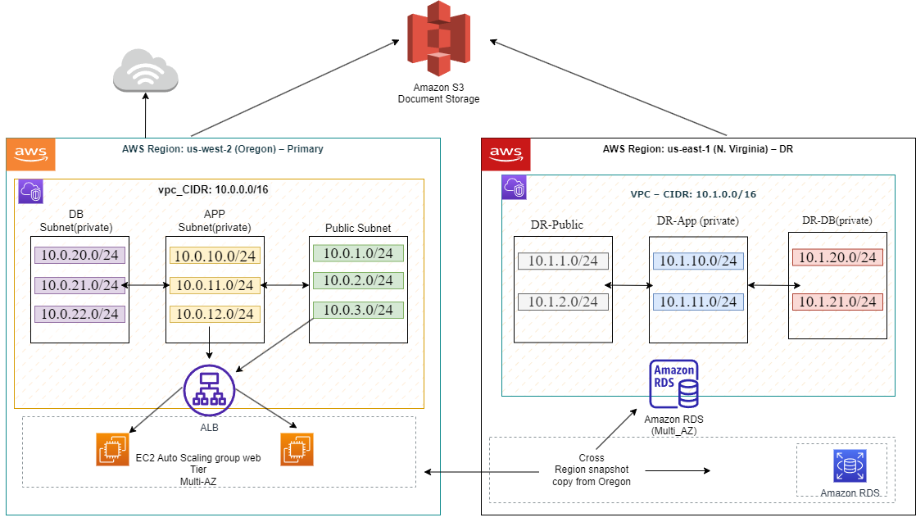
Proposed VPC ArchitectureDiagram

Slide 7
Subnet Table (detailed) Primary (us-west-2)
Subnet Name | VPC | Type | AZ | Subnet Address
Public-1 | 1 | Public | us-west-2a | 10.0.1.0/24
Public-2 | 1 | Public | us-west-2b | 10.0.2.0/24
Public-3 | 1 | Public | us-west-2c | 10.0.3.0/24
App-1 | 1 | Private | us-west-2a | 10.0.10.0/24
App-2 | 1 | Private | us-west-2b | 10.0.11.0/24
App-3 | 1 | Private | us-west-2c | 10.0.12.0/24
DB-1 | 1 | Private (DB) | us-west-2a | 10.0.20.0/24
DB-2 | 1 | Private (DB) | us-west-2b | 10.0.21.0/24
DB-3 | 1 | Private (DB) | us-west-2c | 10.0.22.0/24

Slide 8
Secondary (us-east-1)
Subnet Name | VPC | Type | AZ | Subnet Address
DR-Public-1 | 2 | Public | us-east-1a | 10.1.1.0/24
DR-Public-2 | 2 | Public | us-east-1b | 10.1.2.0/24
DR-App-1 | 2 | Private | us-east-1a | 10.1.10.0/24
DR-App-2 | 2 | Private | us-east-1b | 10.1.11.0/24
DR-DB-1 | 2 | Private (DB) | us-east-1a | 10.1.20.0/24
DR-DB-2 | 2 | Private (DB) | us-east-1b | 10.1.21.0/24

Slide 9
Design – Security Group
Security Group (SG) | SG Name | Rule (Allowed Port) | Source
ELB Load Balancer | sg-alb-public | TCP 80, 443 | 0.0.0.0/0
Web Tier | sg-web-tier | TCP 8080 | ALB Security Group
App Tier | sg-app-tier | TCP 8080 | Web Tier Security Group
Database Tier | sg-db-tier | TCP 3306 (MySQL) | App Tier Security Group

Slide 10
Design – Encryption
Requirement | Solution
Encryption option for data at rest | AWS KMS–managed encryption for RDS (io2), EBS volumes, and S3 buckets
Encryption option for data in transit | TLS 1.2/1.3 for ALB HTTPS traffic, SSL/TLS for RDS connections

Slide 11
Design – Instance Details Instance Specification per Tier
Tier | AMI | Tag | Type | Size | Justification | # of Instances
Web | Amazon Linux 2 | Key: Name Value: web-tier | EC2 | t3.medium | Handles HTTP requests efficiently, cost-effective, supports Auto Scaling | Min 2 / Max 6
App | Amazon Linux 2 | Key: Name Value: app-tier | EC2 | t3.large | Supports document processing and business logic with higher memory | Min 2 / Max 6
DB | N/A (Managed) | N/A | Amazon RDS (MySQL) | db.m6i.large + io2 | High IOPS, Multi-AZ support, fully managed, meets performance and availability requirements | 1 primary + 1 standby

Slide 12
Design: Recovery PointObjective
How would you achieve a Recovery Point Objective (RPO) of four hours?
A Recovery Point Objective (RPO) of four hours is achieved by implementing a multi-layered backup and replication strategy across AWS services. The primary Amazon RDS database in the us-west-2 region is configured with automated backups and frequent transaction log backups, ensuring that data can be restored to a point within the last four hours. In addition, scheduled cross-region snapshot copies are enabled to replicate database backups from the primary region (us-west-2) to the disaster recovery region (us-east-1).
For unstructured data such as customer documents and images, Amazon S3 is used with versioning and cross-region replication enabled. This ensures that object changes are continuously replicated to the secondary region within the required recovery window. Together, automated RDS backups, cross-region snapshot replication, and S3 cross-region replication ensure that in the event of a regional failure, no more than four hours of data is lost, thereby meeting the defined RPO requirement.

Slide 13
Design: DocumentStorage
Storage / Archive Option | Detail
Amazon S3 (Standard) | Amazon S3 Standard is used for active document storage such as user uploads, reports, and application-generated files. It provides high durability (99.999999999%), high availability, and low-latency access. The S3 bucket is hosted in the primary region (us-west-2) and is integrated with the application running in private subnets.
Amazon S3 with Versioning & Cross-Region Replication (CRR) | S3 versioning is enabled to protect against accidental deletion or overwrites. Cross-Region Replication is configured to replicate all documents automatically from the primary region (us-west-2) to the disaster recovery region (us-east-1). This ensures data resilience and supports the four-hour Recovery Point Objective (RPO).

Slide 14
Design: WebTier
Requirement | Solution
Architecture must be flexible and handle any peak in traffic or performance. | Use an EC2 Auto Scaling Group behind an Application Load Balancer (ALB) to automatically scale the number of EC2 instances based on traffic demand, ensuring high availability and performance during peak loads.
The overall acceptable incoming network bandwidth is between 300 Mbps and 750 Mbps. | Deploy an Application Load Balancer and use Amazon CloudWatch to monitor network throughput and request metrics. Configure Auto Scaling policies to add or remove EC2 instances when bandwidth usage increases, ensuring performance stays within acceptable limits.
Application administrators want to be notified by email if there are more than 100 “400 HTTP errors” per minute in the application. | Configure a CloudWatch Alarm to monitor ALB HTTP 4XX error metrics and trigger an Amazon SNS email notification when the error count exceeds 100 per minute.
Web Tier instances should be tagged as “Key=Name” and “Value=web-tier”. | Configure the Auto Scaling Group to automatically apply EC2 tags (Key=Name, Value=web-tier) to all launched web tier instances for easier identification, management, and cost tracking.

Slide 15
Application Tier Design
Requirement | Solution
Architecture must be flexible and handle any peak in traffic or performance. | Use EC2 Auto Scaling Group to automatically adjust capacity based on CPU and memory metrics.
Overall memory and CPU utilization should not go above 80% and 75% respectively or below 30% for either. | Configure CloudWatch alarms to monitor utilization and trigger scaling actions to stay within thresholds.
Internet access is required for patching and updates without exposing the servers. | Deploy NAT Gateways in public subnets to allow outbound internet access from private app instances.

Slide 16
Design: Database Tier
Requirement | Solution
Database needs consistent storage performance at 21,000 IOPS. | Use Amazon RDS with Provisioned IOPS (io1/io2) EBS storage. Provisioned IOPS ensures predictable and consistent high performance suitable for transactional insurance workloads requiring 21,000 IOPS.
High availability is a requirement. | Enable Amazon RDS Multi-AZ deployment. This automatically maintains a synchronous standby replica in a different Availability Zone, providing automatic failover and minimal downtime during failures.
No change to the database schema can be made at this time. | Use a managed relational database engine (Amazon RDS – e.g., MySQL or PostgreSQL). RDS allows lift-and-shift migration without schema changes, ensuring application compatibility and reducing migration risk.

Slide 17
Design – Additional Services
1-Amazon CloudWatch To monitor CPU, memory, and HTTP error metrics across all tiers and trigger alarms for scaling or alerts.
2-Amazon SNS (Simple Notification Service) Used to send email alerts to administrators when 400 HTTP errors exceed 100 per minute.
3-Amazon S3 with Cross-Region Replication Ensures document continuity and durability across primary and DR regions.
4-Amazon RDS Snapshot Copy Supports disaster recovery by preserving database backups across regions, aligned with RPO goals.
5-AWS Auto Scaling Automatically adjusts EC2 capacity in Web and Application tiers to handle performance spikes and maintain target utilization.

Slide 18
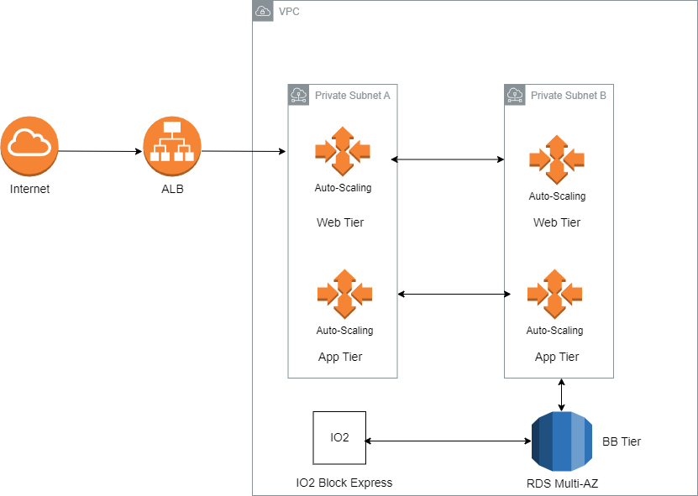
Proposed ArchitectureDiagram

Slide 19
GoGreen Insurance Company Cost Considerations The proposed solution should use the most cost-consciousfinancial options. What are the cost considerations?
Cost-Conscious Financial Options
1- Use Auto Scaling for EC2 instances Automatically adjusts server capacity based on demand, so you only pay for what you use — no overprovisioning.
2- Choose gp3 volumes instead of io2 where possible gp3 offers high performance at a lower cost, and can be tuned to meet IOPS needs unless strict guarantees are required.
3- Implement warm standby in DR region Keeps disaster recovery costs low by running minimal resources that can scale up only when needed.

